Slide 1

SQL
STATEMENTS
By, Ms. P.olynia V. Kharbuli
Dept. of Computer Sc.
St. Anthony’s College, Shillong

Slide 2
Contents
Usage of SQL Statements
Tools of writing SQL Statements
Terms related with SQL Statements
Guideline to write SQL Statements
Tools used to execute SQL statements
How to access the tools?
Working with SQLPlus Worksheet
How to go about writing queries?

Slide 3
Usage of SQL Statement
SQL stands for Structured Query Language
We use SQL statements to store, manage and retrieve data in the database.

Slide 4
The Tools in Writing SQL Statements
Selection capability of SQL is to choose the rows that you want to retrieve from a table. You can specify various criteria while selecting the rows that you want to see.
Projection capability of SQL is to choose the columns in a table that you want to retrieve. You can retrieve selected columns or all columns in a table.
Join capability where the data that is stored in different tables by creating a link between the data in the tables. In addition, you can retrieve data from multiple tables.

Slide 5
Terms related with SQL statements
A keyword starts an individual SQL clause or an element and cannot be abbreviated
A clause refers to part of a SQL statement.
A statement is a combination of clauses placed in a specific order.
Way of executing a SQL statement is by placing a semi-colon at the end of the statement

Slide 6
Guidelines to write statements
Each line of an SQL statement should begin with a keyword
Enter key is used to go to the next line
To enhance readability
Each clause on a separate line.
Enter keywords in uppercase.
All other words, such as table names and column names are entered in lowercase.
To execute the statement, you place a semi-colon at the end of the statement and click the Execute button/Press F5
Note** - SQL statements are not case sensitive

Slide 7
Tools used to execute SQL Statements
Tools that can be used to write and submit the SQL statements to the Oracle server for execution are
SQL *Plus: You need to first log on to SQL *Plus to access the SQL *Plus window
SQLPlus Worksheet: You need to first log on to SQLPlus Worksheet to access the SQLPlus Worksheet window
iSQL *Plus: is a browser-based interface. We can access the iSQL *Plus environment window through any browser

Slide 8
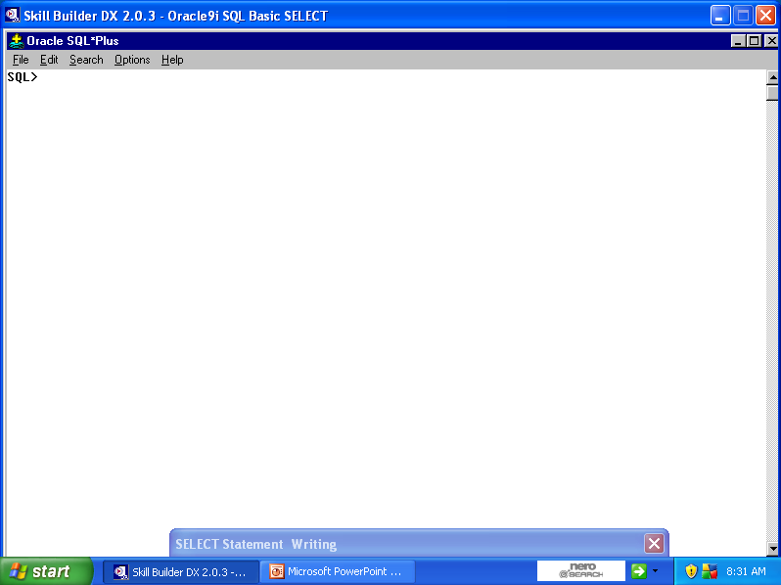
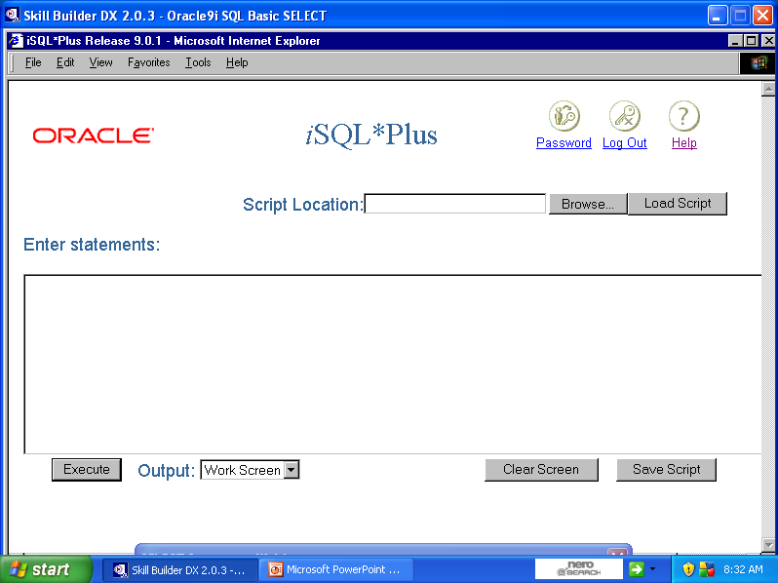
Tools Interface

Slide 9
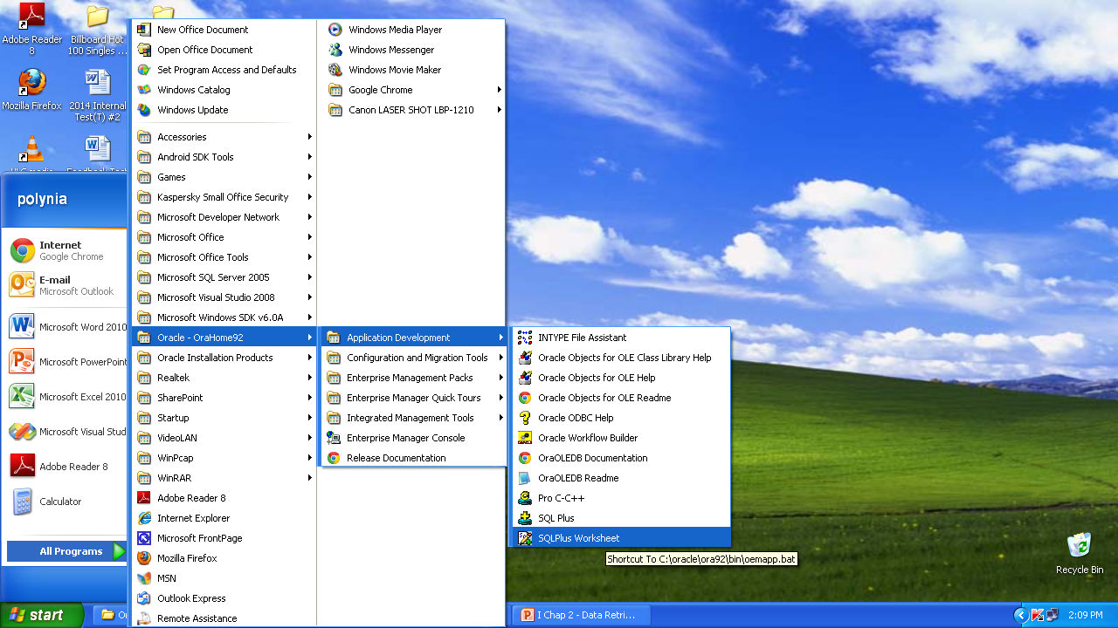
How to access tools?

Slide 10
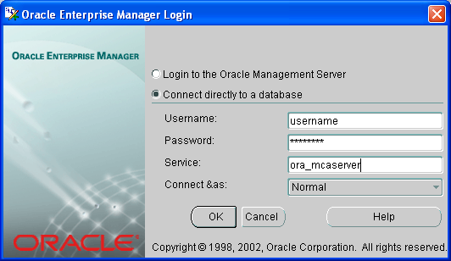
SQLPlus Worksheet - Login

Slide 11
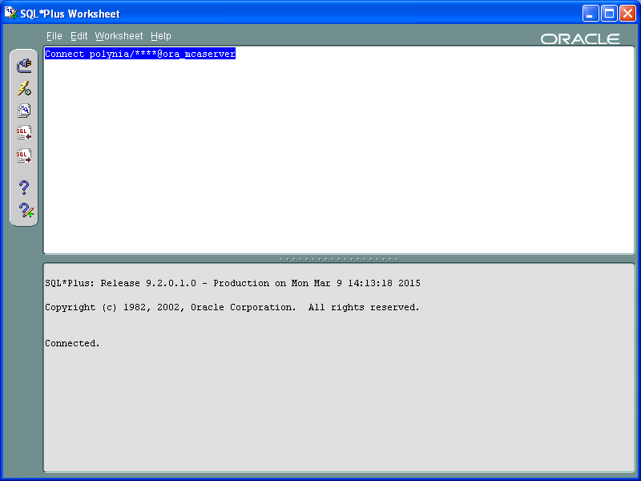
SQLPlus Worksheet - Interface
INPUT:
Commands and
SQL statements are typed here
OUTPUT of Commands and
SQL statements are seen here

Slide 12
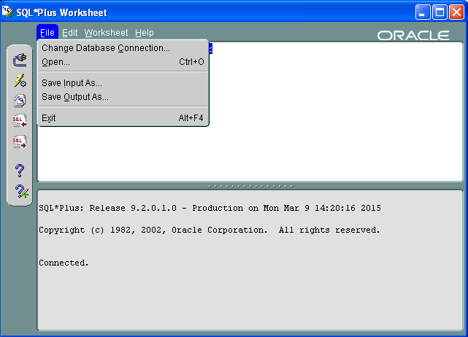
File Menu of SQLPlus Worksheet
Using this option, we can open any file of
.sql extension for execution
Using this option, we save commands typed here
in a file of .sql extension
Using this option, we save output of any commands
that was executed

Slide 13
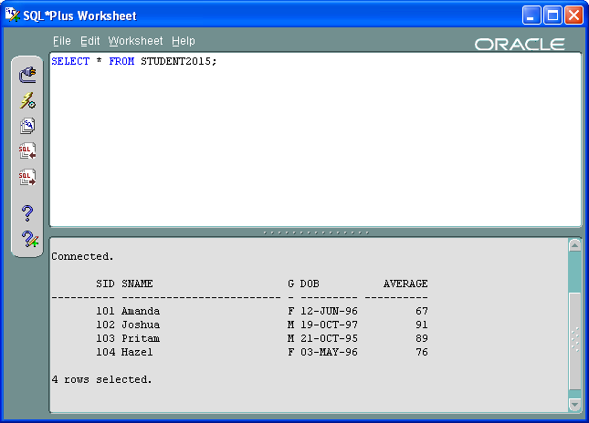
Executing Commands
Shortcut – Press F5 Key to execute commands
Execute Icon

Slide 14
Other Menu
Have a look at the other menus for other features

Slide 15
How to go about writing queries?
Create a folder to store SQL queries
Within it, create separate folder for each worksheet
Open notepad, write the query.
Save the query in the created folder with .sql extension
Login into SQLPlus Worksheet
Open the query file and execute it
If query has errors, debug and remember to re-save in the same file the correct query.

Slide 16


